Slide 1
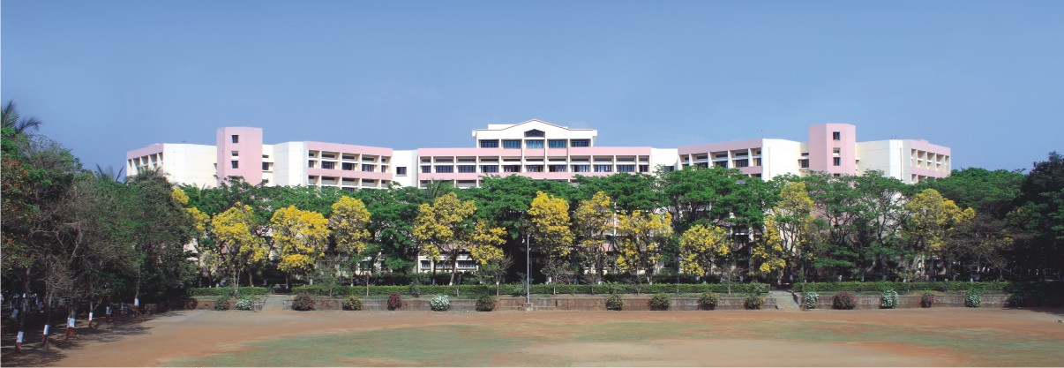

Software Engineering & Project management
Notes:
NOTE:
To change the image on this slide, select the picture and delete it. Then click the Pictures icon in the placeholder to insert your own image.

Slide 2
Unit II
Understanding Requirements and Design Concepts

Slide 3
Contents
Requirement Engineering: Establishing the Groundwork, Eliciting Requirements, Developing the use cases, Building the Requirement model, Negotiate Requirements, Validating Requirements, and Requirement Analysis.
Design Concepts: Design within the context of Software Engineering, The Design Process, Design Concepts, and The Design Model.

Slide 4

Requirement Engineering
Requirements Engineering helps in understanding, what the business impact of the software will be, what the customer wants, and how end users will interact with the software?
The goal of requirement engineering is to develop and maintain sophisticated and descriptive ‘System Requirements Specification’ document.
The broad spectrum of tasks and techniques that lead to an understanding of requirements is called requirements engineering.

Slide 5
Tasks of Requirement Engineering
Inception
Elicitation
Elaboration
Negotiation
Specification
Validation
Management

Slide 6
Inception
In this phase customer and developer meet together and they decide the overall scope and nature of the problem .
Some questions are raised
How does a software project get started?
Is there a single event that becomes the catalyst for a new computer-based system or product, or does the need evolve over time?
In general, most projects begin when a business need is identified or a potential new market or service is discovered.
Discussion is done for the following points
define a business case for the idea,
try to identify the breadth and depth of the market,
do a rough feasibility analysis,
and identify a working
description of the project’s scope.

Slide 7
Elicitation
An important part of elicitation is to establish business goals.
Software engineer should engage stakeholders and encourage them to share their goals honestly.
Multiple problems are occurred in Elicitation phase –
Problem of Scope: occurs when the boundary of the system is ill-defined or the customers and users specify unnecessary technical detail that may confuse, rather than clarify, overall system objective
Problem of Understanding: encountered when customers and users are not completely sure of what is needed, have a poor understanding of the capabilities and limitations of their computing environment
Problems of volatility:-occur when the requirements change over time. To help overcome these problems, you must approach the requirements-gathering activity in an organized manner.

Slide 8
Elaboration
The information obtained from the customer during inception and elicitation is expanded and refined during elaboration.
This task focuses on developing a refined requirements model that identifies various aspects of software function, behaviour, and information.
Elaboration is driven by the creation and refinement of user scenarios that describe how the end user (and other actors) will interact with the system.

Slide 9
Negotiation
It is Relatively common for different customers or users to propose conflicting requirements, arguing that their version is “essential for our special needs.”
These conflicts reconcile through the process of negotiation
Customers, users, and other stakeholders are asked to rank requirements and then discuss conflicts in priority.

Slide 10
Specification
The term specification means different things to different people.
A specification can be a written document, a set of graphical models, a formal mathematical model , a collection of usage scenarios, a prototype, or any combination of these.
Some suggest that a “standard template” should be developed and used for a specification

Slide 11
Validation
The primary requirements validation mechanism is the technical review.
The review team that validates requirements includes
Software engineers,
customers,
users,
and other stakeholders
who examine the specification looking for errors in content.
First requirement Product must be user friendly
The second requirement has a quantitative element

Slide 12
Requirements management
Requirements management is a set of activities that help the project team identify, control, and track requirements and changes to requirements at any time as the project proceeds.

Slide 13
ESTABLISHING THE GROUNDWORK
In an ideal setting, stakeholders and software engineers work together on the same team.
In such cases, requirements engineering is simply a matter of conducting meaningful conversations with colleagues who are well-known members of the team.
The steps to establish the ground-work for an understanding of software requirement to get the project started in a way that will keep it moving forward toward a successful solution
Identifying Stakeholders
Recognizing Multiple Viewpoints
Working toward Collaboration
Asking the First Questions

Slide 14
Identifying Stakeholders
A stakeholder is “anyone who benefits in a direct or indirect way from the system which is being developed.”.
The usual stakeholders are:
business operations managers,
product managers,
marketing people,
internal and external customers,
end users consultants,
product engineers,
software engineers,
support and maintenance engineers
Each stakeholder has a different view of the system, achieves different benefits when the system is successfully developed, and is open to different risks if the development effort should fail.

Slide 15
Recognizing Multiple Viewpoints
Because many different stakeholders exist, the requirements of the system will be explored from many different points of view.
For Example
End users may want features that are familiar to them and that are easy to learn and use.
Software engineers may be concerned with functions that are invisible to nontechnical stakeholders and they enable an infrastructure that supports more marketable functions and features.
Support engineers may focus on the maintainability of the software.
Categorize all stakeholder information in a way that will allow decision makers to choose an internally consistent set of requirements for the system.

Slide 16
Working toward Collaboration
If five stakeholders are involved in a software project, you may have five different opinions about the proper set of requirements.
The job of a requirements engineer is to identify areas of commonality and areas of conflict or inconsistency
Stakeholders collaborate by providing their view of requirements

Slide 17
Asking the First Questions
Questions asked at the inception of the project should be “context free". The first set of context-free questions focuses on the customer and other stakeholders, the overall project goals and benefits.
For example
Who is behind the request for this work?
Who will use the solution?
What will be the economic benefit of a successful solution?
Is there another source for the solution that you need?
The next set of questions enables you to gain a better understanding of the problem and allows the customer to voice his or her perceptions about a solution:
For example
How would you characterize “good” output that would be generated by a successful solution?
What problem(s) will this solution address?
Can you show me (or describe) the business environment in which the solution will be used?
Will special performance issues or constraints affect the way the solution is approached?

Slide 18
Asking the First Questions
The final set of questions focuses on the effectiveness of the communication activity itself.
For example
Are you the right person to answer these questions? Are your answers "official”?
Are my questions relevant to the problem that you have?
Am I asking too many questions?
Can anyone else provide additional information?
Should I be asking you anything else?

Slide 19
ELICITING REQUIREMENTS
Requirements elicitation (also called requirements gathering ) combines elements of
Problem solving (stakeholders work together to identify the problem)
Elaboration (propose elements of the solution)
Negotiation (negotiate different approaches)
Specification (specify a preliminary set of solution requirements)
Collaborative Requirements Gathering
Quality Function Deployment
Usage Scenarios
Elicitation Work Products

Slide 20
Collaborative Requirements Gathering
Different approaches for collaborative requirement Gathering have been proposed –
Meetings (either real or virtual) are conducted and attended by both software engineers and other stakeholders.
Rules for preparation and participation are established.
An agenda is suggested that is formal enough to cover all important points but informal enough to encourage the free flow of ideas.
A “facilitator” (can be a customer, a developer, or an outsider) controls the meeting.
A “definition mechanism” (can be work sheets, flip charts, or wall stickers or an electronic bulletin board, chat room, or virtual forum) is used.

Slide 21
Quality Function Deployment (QFD)
QFD is a quality management technique that translates the needs of the customer into technical requirements for software.
QFD concentrates on maximizing customer satisfaction from the software engineering process
QFD emphasizes an understanding of what is valuable to the customer and then deploys these values throughout the engineering process
QFD identifies 3 types of requirements
Normal Requirements: Normal requirements might be requested types of graphical displays, specific system functions, and defined levels of performance.
Expected Requirements : ease of human/machine interaction, overall operational correctness and reliability, and ease of software installation.
Exciting Requirements : software for a new mobile phone comes with standard features, but is coupled with a set of unexpected capabilities (e.g., multitouch screen, visual voice mail) that delight every user of the product

Slide 22
Usage Scenarios
How the functions and features will be used by different classes of end users?
To accomplish this, the developers and users can create a set of scenarios that identify a thread of usage for the system to be constructed.
The scenarios, often called use case which provide a description of how the system will be used.

Slide 23
Elicitation Work Products
The work products produced as a consequence of requirements elicitation will vary depending on the size of the system or product to be built.
The information of requirement gathering includes -
a statement of need and feasibility,
a bounded statement of scope for the system or product,
a list of customers, users, and other stakeholders who participated in requirements elicitation,
a description of the system’s technical environment,
a list of requirements (preferably organized by function) and the domain constraints that applies to each,
a set of usage scenarios that provide insight into the use of the system or product under different operating conditions, and
any prototypes developed to better define requirements

Slide 24
DEVELOPING USE CASES
A use case describes the system’s behaviour according to the response received from it’s stakeholders.
A use case tells about how an end user interacts with the system under a specific set of circumstances.
A use case depicts the software or system from the end user’s point of view
The first step in writing a use case is to define the set of “actors”
Actors are the different people (or devices) that use the system or product within the context of the function and behaviour that is to be described.
Actors represent the roles that people play as the system operates.
An actor communicates with the system and that is external to the system itself.
Every actor has one or more goals when using the system.
Once actors have been identified, use cases can be developed

Slide 25
Use-Cases
 A collection of user scenarios that describe the thread of usage of a system
 Each scenario is described from the point-of-view of an “actor"
 Each scenario answers the following questions:
 Who is the primary actor, the secondary actor (s)?
 What are the actor’s goals?
 What preconditions should exist before the story begins?
 What main tasks or functions are performed by the actor?
 What extensions might be considered as the story is described?
 What variations in the actor’s interaction are possible?
 What system information will the actor acquire, produce, or change?
 Will the actor have to inform the system about changes in the external environment?
 What information does the actor desire from the system?
 Does the actor wish to be informed about unexpected changes?

Slide 26
Use case diagram
A use case diagram is a graphical depiction of a user's possible interactions with a system.
A use case diagram shows various use cases and different types of users the system has and will often be accompanied by other types of diagrams as well.
The use cases are represented by either circles or ellipses.
The actors are often shown as stick figures.

Slide 27
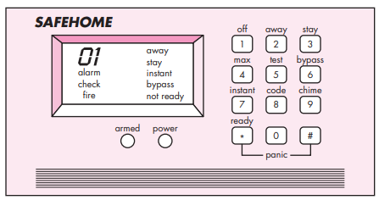
Use Case: SafeHome
Four actors:
homeowner (a user),
setup manager (likely the same person as homeowner, but playing a different role),
sensors (devices attached to the system), and
monitoring and response subsystem (the central station that monitors the SafeHome home security function).

Slide 28
Detailed description of use case for home security function
Use case: Initiate Monitoring
Primary actor: Homeowner
Goal in context: To set the system to monitor sensors when homeowner leaves the house
Preconditions: System has been programmed for a password and to recognise various sensors
Trigger: The homeowner decides to “set” the system i.e. to turn on the alarm function
Scenario:
Homeowner: observes control panel
Homeowner: enters password
Homeowner: selects “stay” or “away”
Homeowner: observes read alarm light to indicate that the system has been armed

Slide 29
Detailed description of use case for home security function
Exceptions:
Control panel is not ready: homeowner checks all sensors to determine which are open; closes them.
Password is incorrect (control panel beeps once): homeowner reenters correct password.
Password not recognized: monitoring and response subsystem must be contacted to reprogram password.
Stay is selected: control panel beeps twice and a stay light is lit; perimeter sensors are activated.
Away is selected: control panel beeps three times and an away light is lit; all sensors are activated.

Slide 30
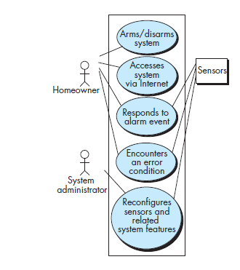
UML use case diagram for home security function

Slide 31
Use case : A Bank ATM
Usage Scenario:
Customer (actor) uses bank ATM to Check Balances of his/her bank accounts, Deposit Funds, Withdraw Cash and/or Transfer Funds (use cases).
ATM Technician provides Maintenance and Repairs.
All these use cases also involve Bank actor whether it is related to customer transactions or to the ATM servicing.

Slide 32
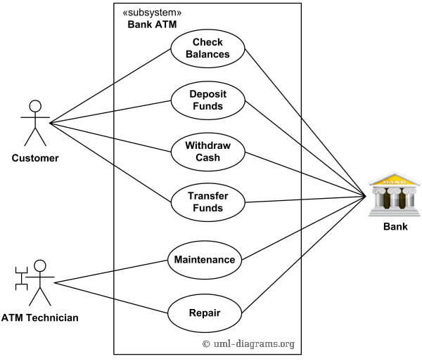
Use case for a Bank ATM

Slide 33
BUILDING THE REQUIREMENTS MODELS
The intent of the analysis model is to provide a description of the required informational, functional, and behavioral domains for a system
The analysis model is a snapshot of requirements at any given time, you should expect it to change.

Slide 34
Elements of the Requirements Model
Requirements for a computer-based system can be seen in many different ways.
The specific elements of the requirements model are dedicated to the analysis modeling method that is to be used.
Scenario-based elements
Class-based elements
Behavioral elements
Flow-oriented elements

Slide 35
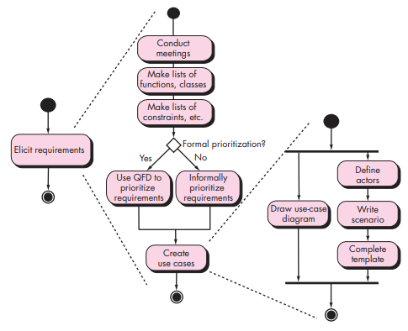
Scenario-based elements
The system is described from the user’s point of view using a scenario-based approach
Scenario-based elements of the requirements model are often the first part of the model that is developed
Figure depicts a UML activity diagram for eliciting requirements and representing them using use cases.
UML activity diagram for eliciting requirements

Slide 36
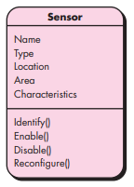
Class diagram for Sensor
Class-based elements
Each usage scenario implies a set of objects that are manipulated as an actor interacts with the system.
These objects are categorized into classes—a collection of things that have similar attributes and common behaviors.
A UML class diagram can be used to depict a Sensor class for the SafeHome security function.
Note that the diagram lists the attributes of sensors and the operations that can be applied to modify these attributes.

Slide 37
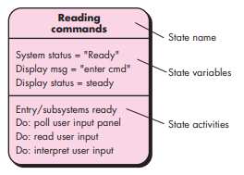
UML State Diagram notation
Behavioral elements
The state diagram is one method for representing the behavior of a system by depicting its states and the events that cause the system to change state.
A state is any externally observable mode of behavior.
The state diagram indicates actions taken as a consequence of a particular event.
To illustrate the use of a state diagram, consider software embedded within the SafeHome control panel that is responsible for reading user input.

Slide 38
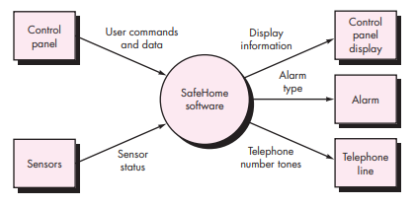
Flow-oriented elements
Information is transformed as it flows through a computer-based system. The system accepts input in a variety of forms, applies functions to transform it, and produces output in a variety of forms.
One can create a flow model for any computer-based system, regardless of size and complexity.
Context-level DFD for the SafeHome security function

Slide 39
Negotiating Requirements
Stakeholders are asked to balance functionality, performance, and other product or system characteristics against cost and time-to-market.
The intent of this negotiation is to develop a project plan that meets stakeholder needs while at the same time reflecting the real-world constraints (e.g., time, people, budget) that have been placed on the software team.
The best negotiations strive for a “win-win” result.
Stakeholders win by getting the system or product that satisfies the majority of their needs and software team win by working to realistic and achievable budgets and deadlines

Slide 40
Validating Requirements
Each element of the requirements model is examined for inconsistency, omissions, and ambiguity.
The requirements represented by the model are prioritized by the stakeholders and grouped within requirements packages that will be implemented as software increments.

Slide 41
Design concept
Software design encompasses the set of principles, concepts, and practices that lead to the development of a high-quality system or product.
It is the place where stakeholder requirements, business needs, and technical considerations all come together in the formulation of a product or system.
Design creates a representation or model of the software
The design model provides detail about software architecture, data structures, interfaces, and components that are necessary to implement the system.

Slide 42

SDLC Phases

Slide 43
Design manifesto
The goal of design is to produce a model or representation that exhibits firmness, commodity, and delight.
Firmness: A program should not have any bugs that inhibit its function.
Commodity: A program should be suitable for the purposes for which it was intended.
Delight: The experience of using the program should be a pleasurable one.

Slide 44
Design Within The Context Of Software Engineering
The importance of software design can be stated with a single word—quality.
Design is the place where quality is fostered in software engineering.
Design provides you with representations of software that can be assessed for quality.
Design is the only way that you can accurately translate stakeholder’s requirements into a finished software product or system.
Software design serves as the foundation for all the software engineering and software support activities that follow.

Slide 45
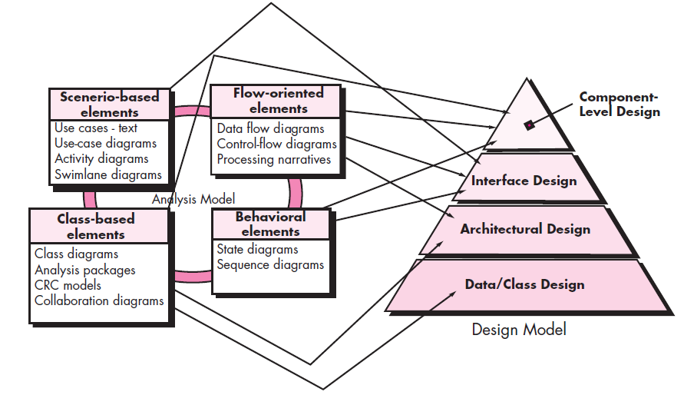
Design Within The Context Of Software Engineering
Figure : Translating the requirement model into the design model

Slide 46
The Design process
Software design is an iterative process through which requirements are translated into a “blueprint” for constructing the software.
The design is represented at a high level of abstraction—a level that can be directly traced to the specific system objective and more detailed data, functional, and behavioral requirements.

Slide 47
Software Quality Guidelines and Attributes
Three characteristics of a good design -
The design must implement all of the explicit requirements contained in the requirements model, and it must accommodate all of the implicit requirements desired by stakeholders.
The design must be a readable, understandable guide for those who generate code and for those who test and subsequently support the software.
The design should provide a complete picture of the software, addressing the data, functional, and behavioural domains from an implementation perspective.

Slide 48
Quality Guidelines
A design should exhibit an architecture
A design should be modular
A design should contain distinct representations of data
A design should lead to data structures that are appropriate for the classes
A design should lead to components that exhibit independent functional characteristics
A design should lead to interfaces that reduce the complexity of connections
A design should be derived using a repeatable method
A design should be represented using a notation that effectively communicates its meaning

Slide 49
Quality Attributes (FURPS)
Functionality
assessed by evaluating the feature set and capabilities of the program
Usability
assessed by considering human factors
Reliability
evaluated by measuring the frequency and severity of failure
Performance
measured by considering processing speed, response time, resource consumption etc.
Supportability
combines the ability to extend the program (extensibility), adaptability, serviceability

Slide 50
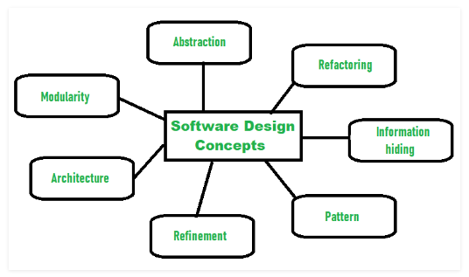
Design Concepts
The software design concept simply means the idea or principle behind the design.
Figure presents a brief overview of important software design concepts that span both traditional and object-oriented software development.

Slide 51
Design Concepts
Abstraction- hide irrelevant data
Modularity- subdivide the system
Architecture- design a structure of something
Refinement- removes impurities
Pattern- a repeated form
Information Hiding- hide the information
Refactoring- reconstruct something

Slide 52
1. Abstraction
At the highest level of abstraction, a solution is stated in broad terms using the language of the problem environment.
At lower levels of abstraction, a more detailed description of the solution is provided
Levels of abstractions :
Procedural abstraction - refers to a sequence of instructions that have a specific and limited function.
Data abstraction - is a named collection of data that describes a data object.

Slide 53
2. Architecture
Software architecture refers to “the overall structure of the software and the ways in which that structure provides conceptual integrity for a system”.
In its simplest form, architecture is the structure of program components, the manner in which these components interact, and the structure of data that are used by the components.

Slide 54
2. Architecture
A set of properties describes specified part of an architectural design:
Structural properties
defines the components of a system (e.g., modules, objects, filters) and the manner in which those components interact with one another
Extra-functional properties
how the design architecture achieves requirements for performance, capacity, reliability, security, adaptability, and other system characteristics.
Families of related systems
the design should have the ability to reuse architectural building blocks.

Slide 55
2. Architecture
The architectural design can be represented using one or more of a number of different models.
Structural models
represent architecture as an organized collection of program components
Framework models
increase the level of design abstraction by attempting to identify repeatable architectural design frameworks
Dynamic models
address the behavioral aspects of the program architecture
Process models
focus on the design of the business or technical process that the system must accommodate
Functional model
can be used to represent the functional hierarchy of a system.

Slide 56
3. Patterns
Brad Appleton defines a design pattern : “A pattern is a named nugget of insight which conveys the essence of a proven solution to a recurring problem within a certain context among competing concerns”.
The intent of each design pattern enables a designer to determine
whether the pattern is applicable to the current work
whether the pattern can be reused
Whether the pattern can serve as a guide for developing a similar, but functionally or structurally different pattern.

Slide 57
4. Separation of Concerns
Separation of concern is a design concept that suggests that any complex problem can be more easily handled if it is subdivided into pieces that can each be solved and/or optimized independently.
A concern is a feature or behavior that is specified as part of the requirements model for the software.
By separating concerns into smaller, and therefore more manageable pieces, a problem takes less effort and time to solve.

Slide 58
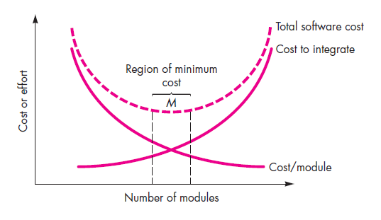
5. Modularity
Modularity is the most common manifestation of separation of concerns.
Software is divided into separately named and addressable components, sometimes called modules, that are integrated to satisfy problem requirements.
Figure :Modularity and software cost

Slide 59
6. Information Hiding
The principle of information hiding suggests that modules be “characterized by design decisions that (each) hides from all others.”
In other words, modules should be specified and designed so that information (algorithms and data) contained within a module is inaccessible to other modules.

Slide 60
7. Functional Independence
The concept of functional independence is a direct outgrowth of separation of concerns, modularity, and the concepts of abstraction and information hiding.
Design a software so that each module addresses a specific subset of requirements and has a simple interface when viewed from other parts of the program structure.
Software with independent modules is easier to develop and also easier to maintain and test.
Functional independence is a key to good design, and design is the key to software quality.

Slide 61
8. Refinement
Refinement is actually a process of elaboration.
Refinement helps you to reveal low-level details as design progresses.
Stepwise refinement is a top-down design strategy.
A program is developed by successively refining levels of procedural detail. A hierarchy is developed by decomposing a macroscopic statement of function in a stepwise fashion until programming language statements are reached.

Slide 62
9. Aspects
A requirements model can be organized in a way that allows you to isolate each concern (requirement) so that it can be considered independently.
An aspect is a representation of a crosscutting concern.
It is important to identify aspects so that the design can properly accommodate them as refinement and modularization occur.
In an ideal context, an aspect is implemented as a separate module.
An aspect is a module that enables the concern to be implemented across all other concerns that it crosscuts.

Slide 63
10. Refactoring
Refactoring is a reorganization technique that simplifies the design (or code) of a component without changing its function or behaviour.
“Refactoring is the process of changing a software system in such a way that it does not alter the external behavior of the code yet improves its internal structure.”
When software is refactored, the existing design is examined for redundancy, unused design elements, inefficient or unnecessary algorithms, poorly constructed or inappropriate data structures, or any other design failure that can be corrected to yield a better design.

Slide 64
11. Object-Oriented Design Concepts
The object-oriented (OO) paradigm is widely used in modern software engineering.
OO design concepts such as classes and objects, inheritance, messages, and polymorphism, among others are used.

Slide 65
12. Design Classes
A set of design classes that refine the analysis classes by providing design detail that will enable the classes to be implemented, and implement a software infrastructure that supports the business solution.
Design classes present significantly more technical detail as a guide for implementation.
Five different types of design classes, each representing a different layer of the design architecture, can be developed
User interface classes define all abstractions that are necessary for human computer interaction (HCI).
Business domain classes identify the attributes and services (methods) that are required
Process classes implement lower-level business abstractions required to fully manage the business domain classes.
Persistent classes represent data stores (e.g., a database) that will persist beyond the execution of the software.
System classes implement software management and control functions that enable the system to operate and communicate within its computing environment and with the outside world.

Slide 66
The Design Model
The design model can be viewed in two different dimensions.
The process dimension indicates the evolution of the design model as design tasks are executed as part of the software process.
The abstraction dimension represents the level of detail as each element of the analysis model is transformed into a design equivalent and then refined iteratively.
The dashed line indicates the boundary between the analysis and design models.

Slide 67
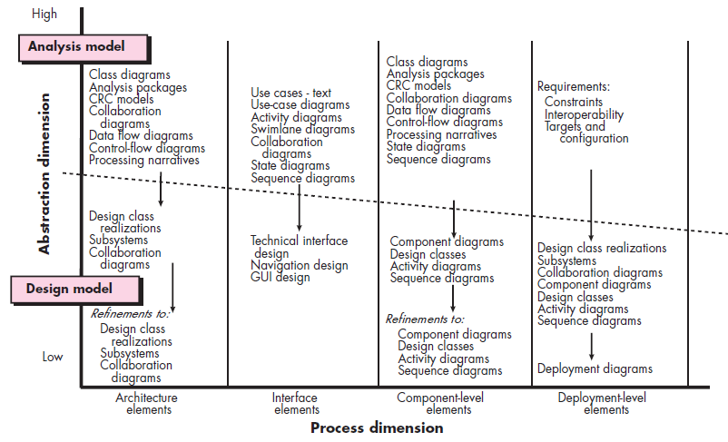
The Design Model
Figure: Dimensions of the design model

Slide 68
1. Data Design Elements
Data design creates a model of data and/or information that is represented at a high level of abstraction.
This data model is then refined into progressively more implementation-specific representations that can be processed by the computer-based system.
In many software applications, the architecture of the data will have a profound influence on the architecture of the software that must process it.
The structure of data has always been an important part of software design

Slide 69
2. Architectural Design Elements
The architectural design for software is equivalent to the floor plan of a house.
Architectural design elements give us an overall view of the software.
The architectural model is derived from three sources:
information about the application domain for the software to be built;
specific requirements model elements such as data flow diagrams or analysis classes, their relationships and collaborations for the problem at hand;
(3) the availability of architectural styles and patterns

Slide 70
3. Interface Design Elements
The interface design elements for software depict information flows into and out of the system and how it is communicated among the components defined as part of the architecture.
There are three important elements of interface design:
(1) the user interface (UI);
(2) external interfaces to other systems, devices, networks, or other producers or consumers of information;
(3) internal interfaces between various design components.
These interface design elements allow the software to communicate externally and enable internal communication and collaboration among the components that populate the software architecture.

Slide 71
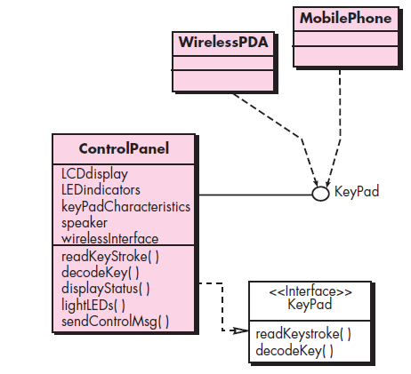
3. Interface Design Elements
Figure: Interface representation for Control- Panel

Slide 72
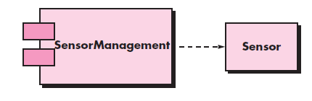
4. Component-Level Design Elements
The component-level design for software fully describes the internal detail of each software component.
The component-level design defines data structures for all local data objects and algorithmic detail for all processing that occurs within a component and an interface that allows access to all component operations (behaviors).
Figure: A UML component diagram

Slide 73
5. Deployment-Level Design Elements
Deployment-level design elements indicate how software functionality and subsystems will be allocated within the physical computing environment that will support the software.
Deployment diagrams begin in descriptor form, where the deployment environment is described in general terms. Later, instance form is used and elements of the configuration are explicitly described.

Slide 74
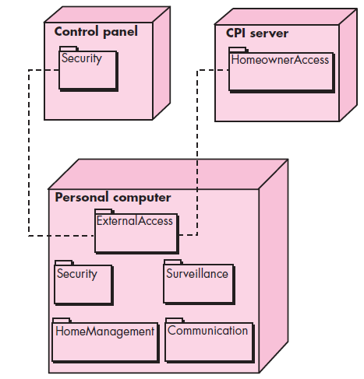
5. Deployment-Level Design Elements
Figure: A UML deployment diagram

Slide 75
Thank You

